Slide 1
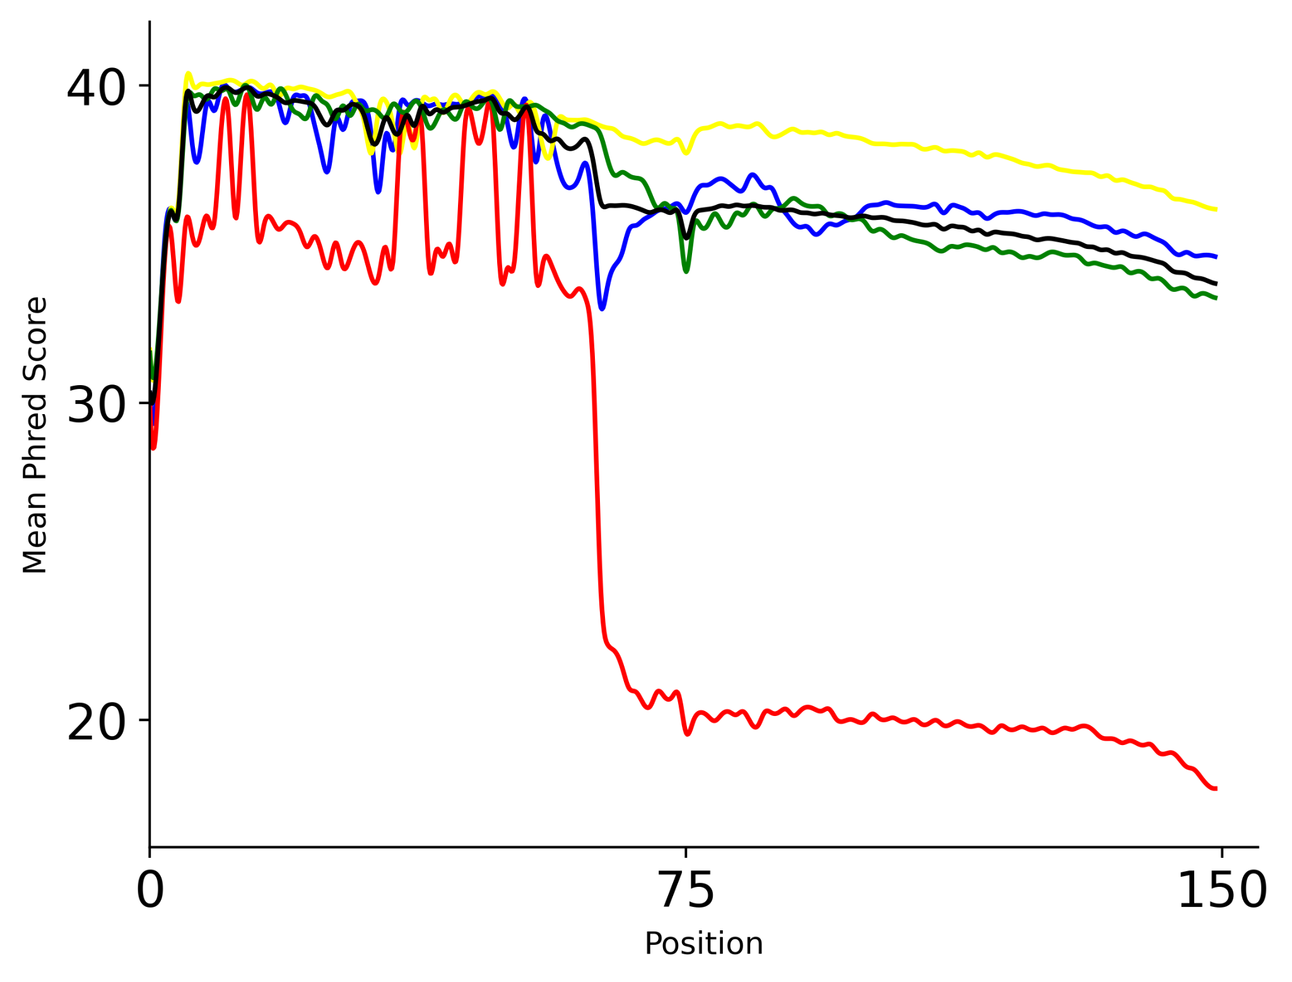
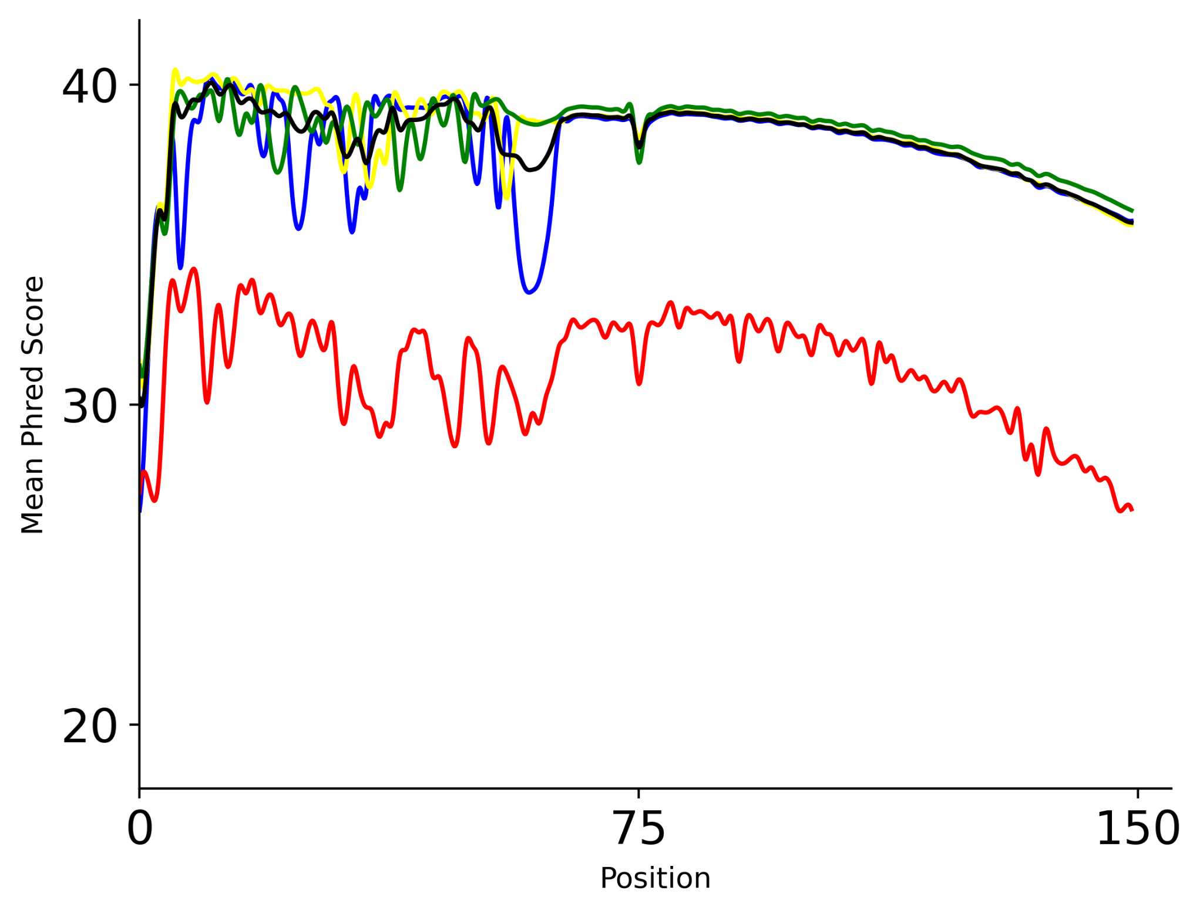
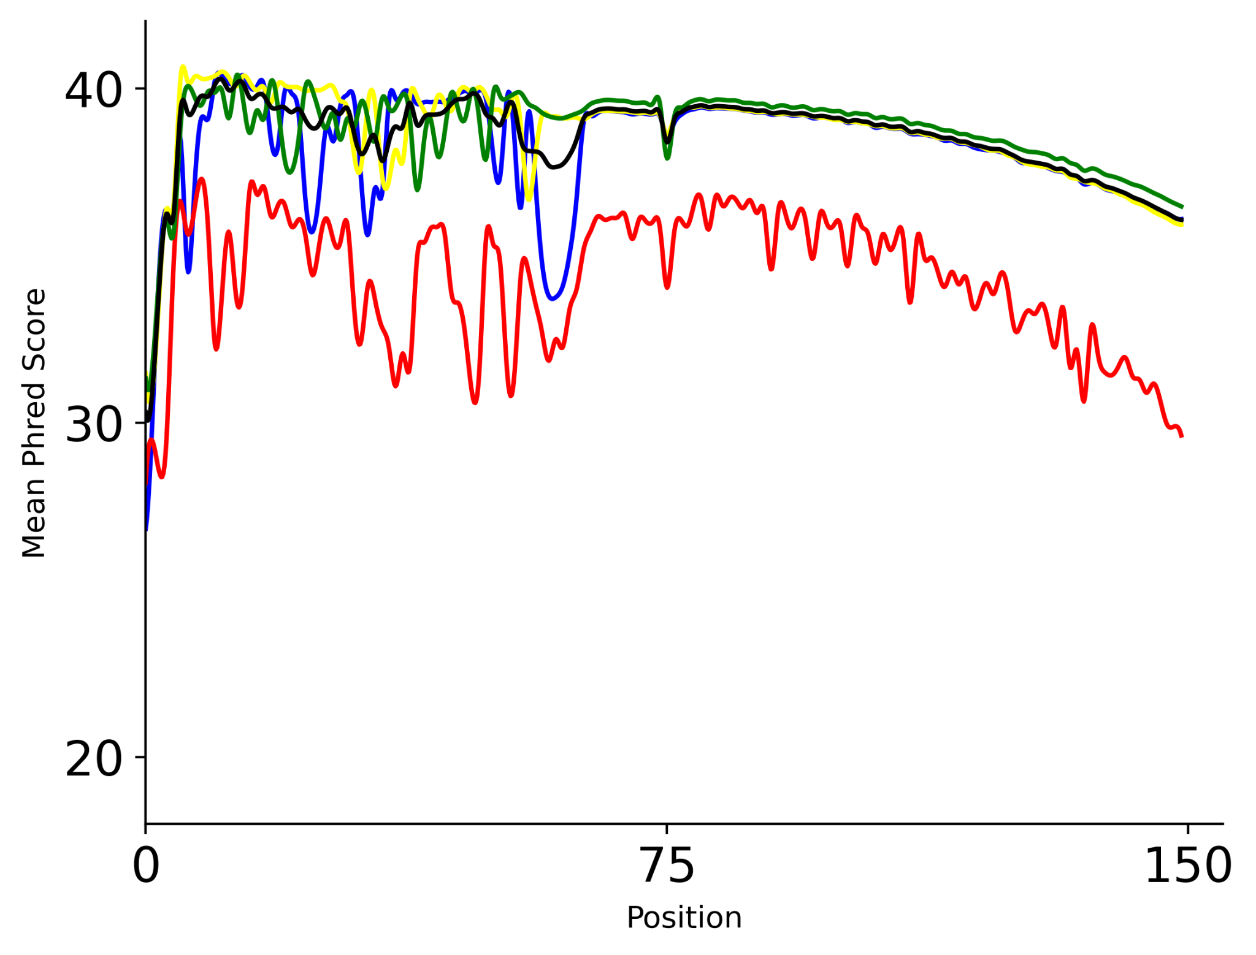

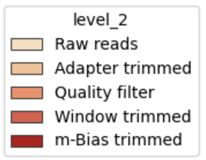
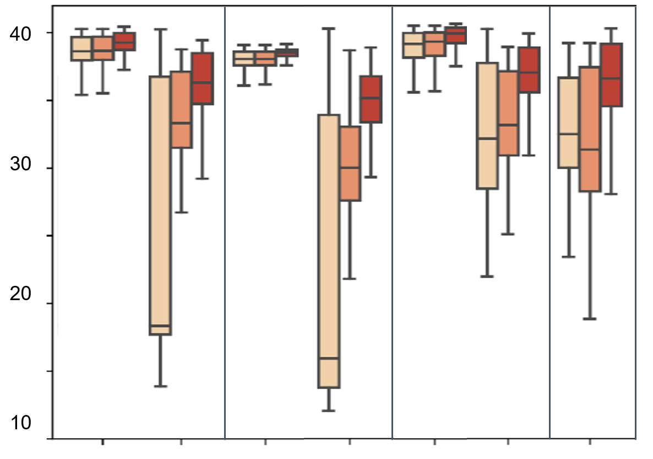
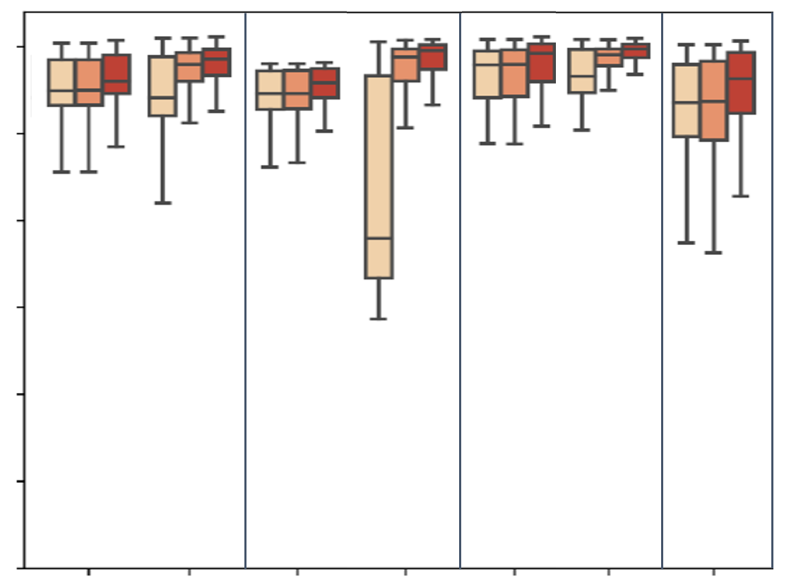
A
B
C
40
30
20
Mean Phred
0 | 75 | 150
0 | 75 | 150
0 | 75 | 150
Position (bp)
D
Raw reads
p-m⁵C sites
All bases
Sequence trim
Quality filter
40
30
20
10
Total RNA
Polysomal RNA
MT RNA
Huang
Total RNA
Polysomal RNA
MT RNA
Huang
RNAseq
RNAseq
RNAseq
RNA BS-seq
RNAseq
RNAseq
RNAseq
RNA BS-seq
RNA BS-seq
RNA BS-seq
RNA BS-seq
RNA BS-seq
Notes:
(A-C) Mean Phred score per base sequence of adenosine (blue), thymine (yellow), guanine (green), and cytosine (red) in Total RNA bisulfite data sets throughout the sequence cleaning process. (A) represents raw reads, (B) represents reads after adapter and poly-X trimming, and (C) represents reads after base quality filtering. (D) boxplot of mean base-level Phred scores at each step of the sequence cleaning pipeline (shades of red). p–m⁵C sites are considered to be “Cs” in Read 1 and “Gs” in Read 2. p-m5C bases are depicted in the left figure, and the average of all nucleotides are represented in the right figure.

